Slide 1

START ROMAGNA
Francesco Lepri
Hassan Diban
Dalmar Abdi Rage
Saksham Yoshi

Slide 2
Roadmap & Objectives
October
November
Dec/Jan
February
Creation of Cashless payment Questionnaire
Development of Score system and Experience QR code
Collection of data through all Romagna and analysis
Final Report creation and collaboration with other groups
01
02
03
04

Slide 3

Our Questionnaire
The main objective of the questionnaire is to understand why people use or don't use the online applications and the Startap device present onboard.
To do so we collected as many data as possible to have a clear vision in mind of what were the main problems to overcome.

Slide 4
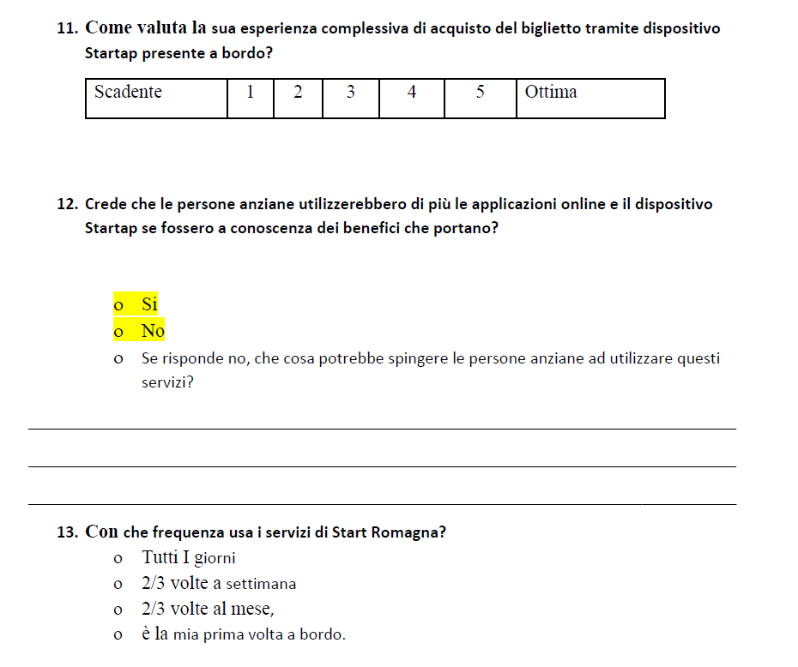
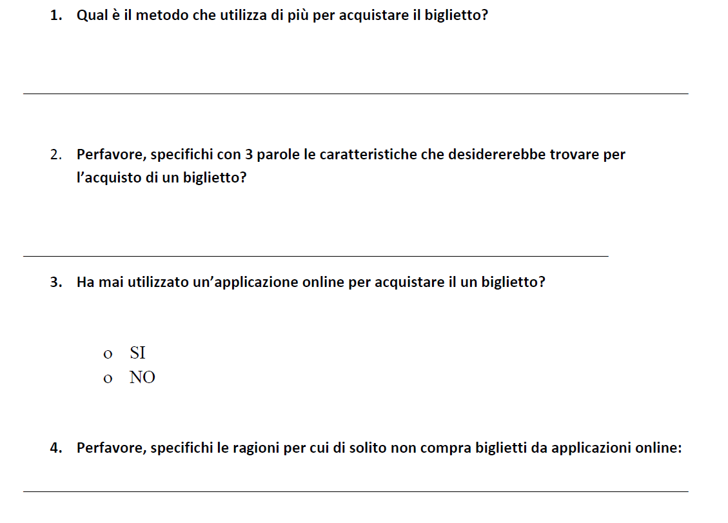
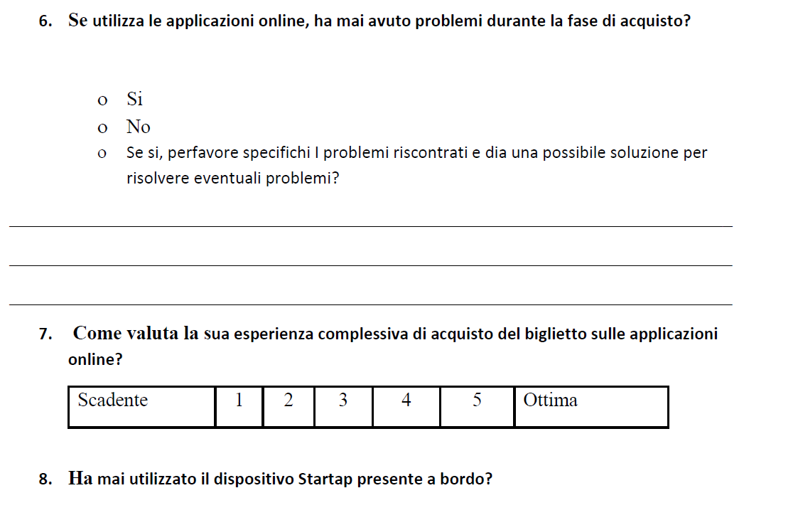
Some key questions

Slide 5
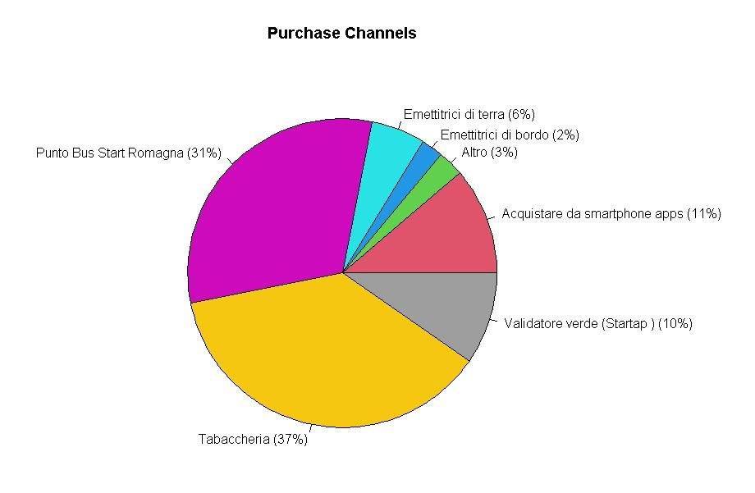

Analysis results and considerations

Slide 6
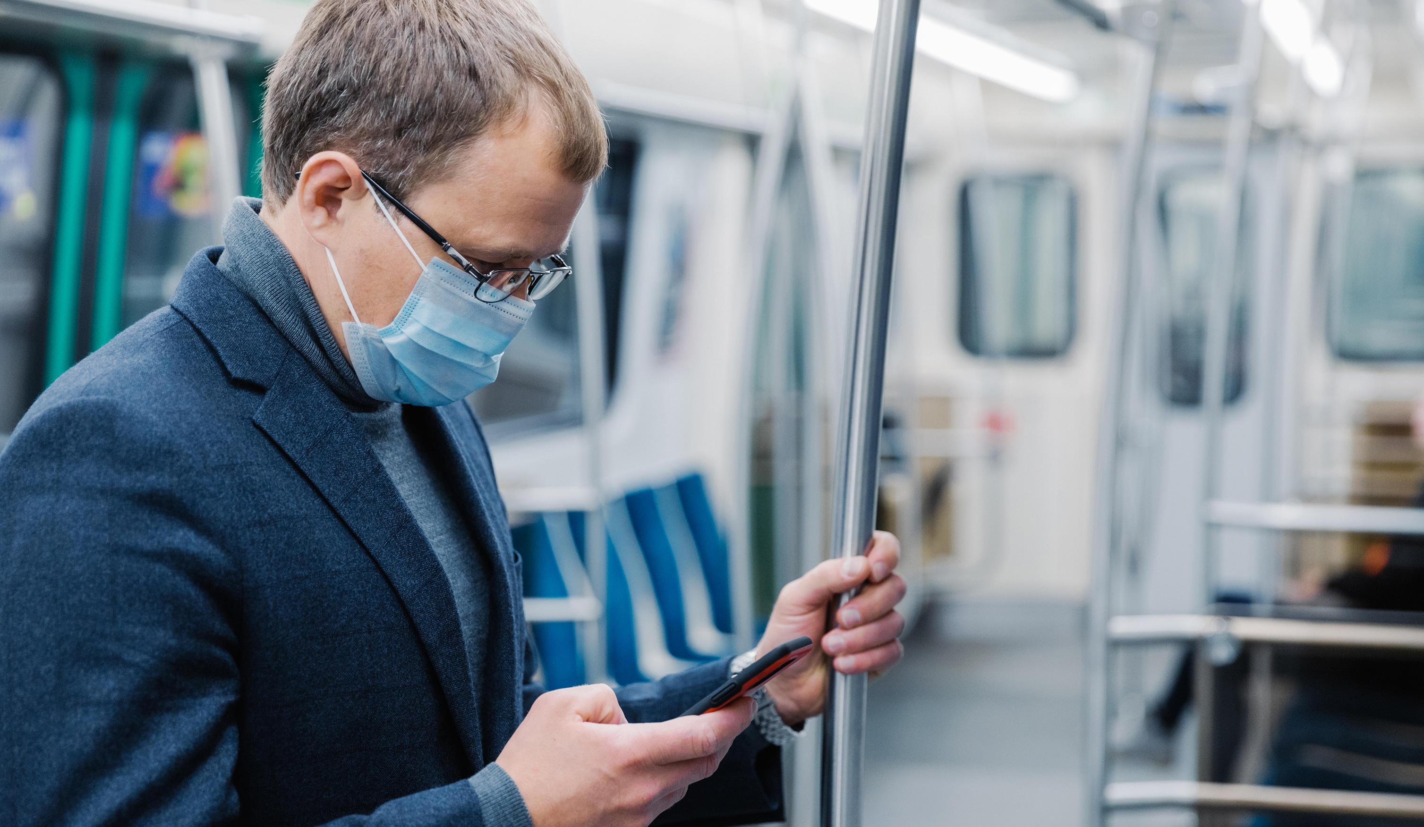
The customer's experience onboard
To understand what customers feel when using Start Romagna services we created a brief questionnaire that will be available to all customers onboard thanks to the use of their smartphones and our QR code.
The customers will have the possibility to rate the Bus according to their experience, levels of safety, punctuality...

Slide 7



The score system & Start Token
One of the objectives that Start Romagna wants to achieve in the long run is to decrease its overall environmental impact.
To do so we thought about a "score system" which gives incentives and prizes to all those customers who are willing to buy their tickets through apps and cashless devices.

Slide 8

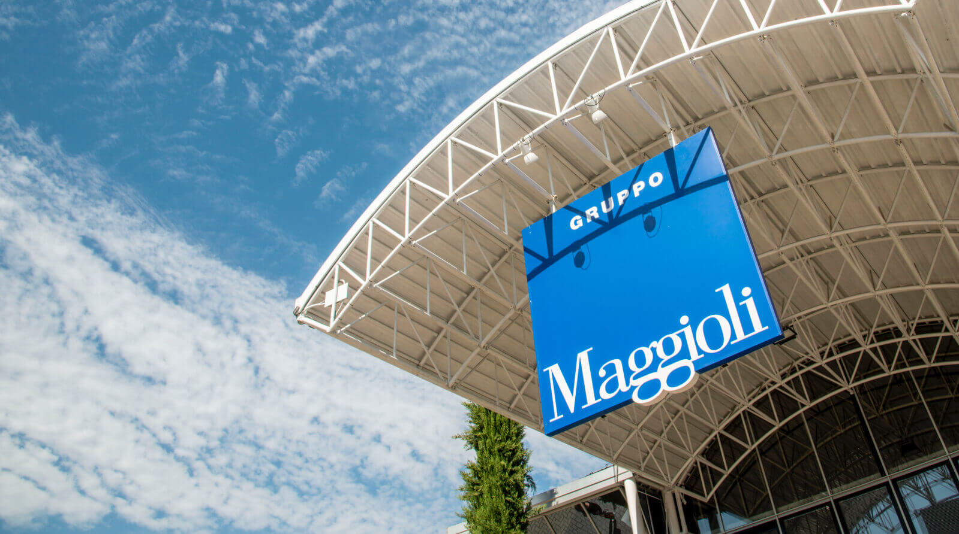
The Network
We collaborated with Maggioli and Museo Fellini in order to reach this objective.
We thought that Museo Fellini could become a potential partner to grant people who use our services a visit in the museum as a prize for having reduced the overall pollution.
Maggioli Group gave us the possibility to use their online App "Municipium" to develop our score system and add an additional way of tiketing.

Slide 9

Thank You !

